Slide 1

Introduction
Food and beverages
In
Real Energy Stadium
Cafeteria

Slide 2
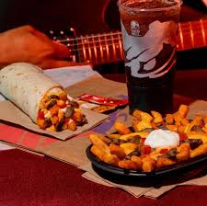
About the stadium
Real energy stadium is one of the best stadiums in NFL, having a capacity of 67,895 it has been considered the largest stadium in the US. The stadium was built in August 199 which coated $284 million. The venue size of the Real Energy is 1.64 million square feet sitting on a 31 acre land. The stadium is made up of high standard Kentucky bluegrass having a sand soul zone and the underground is fitted with a heat system that has a piping of 40miles hence considered the best venue for most NFL games. It has 144 suites that contains a 16 seats per suite.

Slide 3
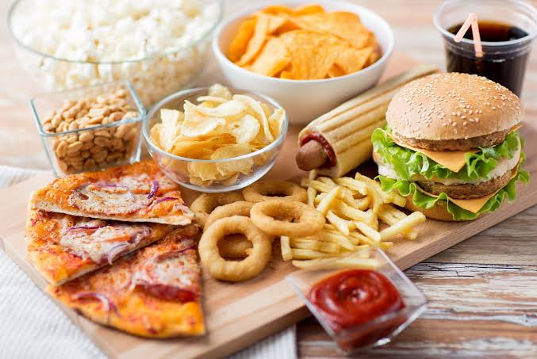
Cost for preparation
The cost to prepare defer depending on the meals. When it comes to the chilled fries the cost to prepare is higher because it needs potatoes, oil and power hence coming to a cost of $7. For sausages we buy cooked sausages from the farmers choice company at $2 per sausage and add $1 for power. (Miles et al 139) Nachos require skilled experts hence making its preparation cost higher. Beer is bought from the national breweries at $3. Hot links and nuggets are prepared using chicken which we get them from our local farm hence Making it cheaper for us.

Slide 4
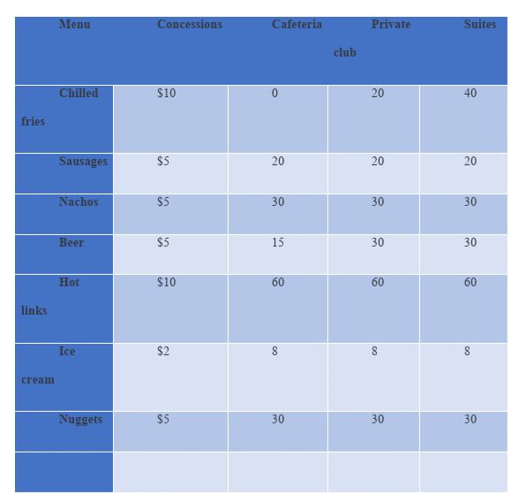
Menu
Notes:
Food and beverage are considered essential when it comes to stadiums and public arena because the target customers are the huge number of fans attending the events. When it comes to the NFL and the Real Energy stadium to be specific, most of the fans fill the stadiums to watch their games hence making it good for the food and beverage business. Having a capacity of above 67,000, most of them need some snack or drink when watching the games. When we go through the 2020 season, the initiative makes the Realers team as one of the first teams to include food and beverage items as one of the essential benefits for their ticket holders.

Slide 5
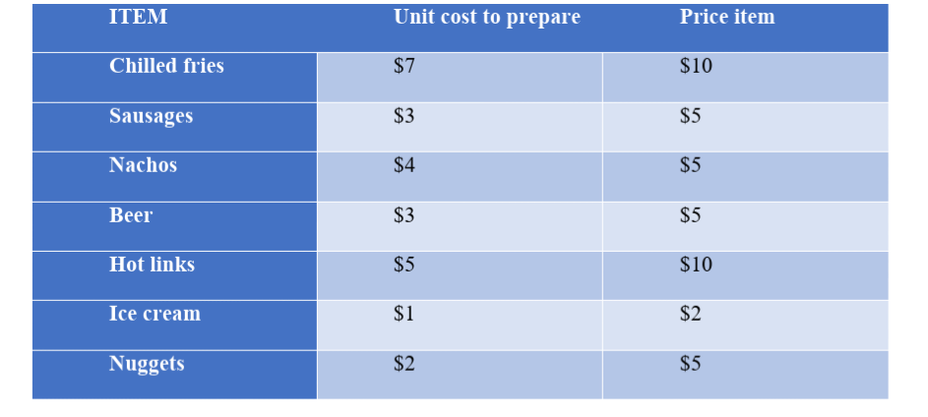
Cost comparison
Notes:
Our main foods and beverages for the stadium is beer and chilled fries which will be sold to the fans in the main arena. The beer will be stored in the basement whereby it will have low temperatures so that it can brew well while the potatoes will also be stored in a warehouse set aside by the stadium management. The production process will take place in the cafeteria and only the beers will be stored again after production. We shall ensure all fries are sold and what remains will be disposed.

Slide 6
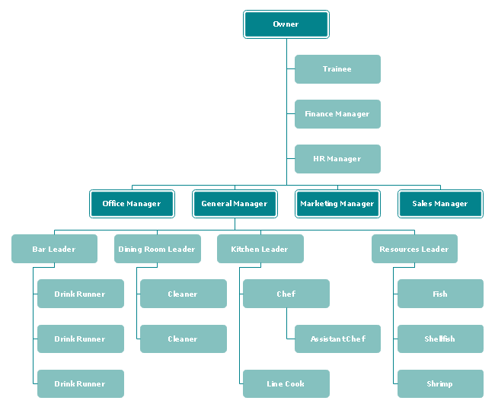
Management chart

Slide 7
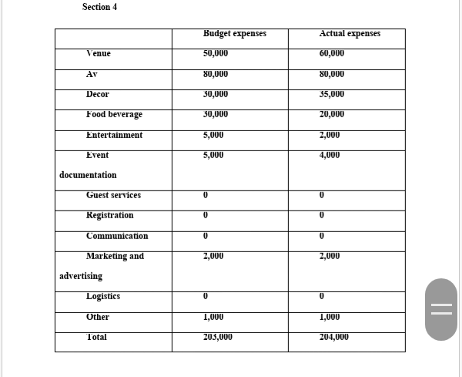

Slide 8
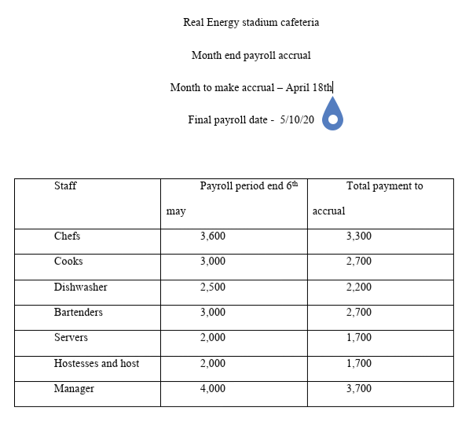

Slide 9
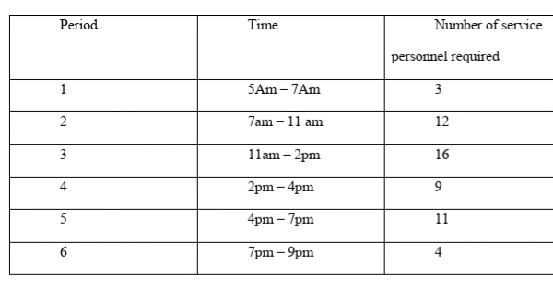
Notes:
The members in the clubs prefer beverages like Pepsi, beer and whiskey while for the members in the clubs, they prefer special meals from the buffet and drink like whiskey and wine. The stadium management treats the members as their family and we know that if the members are willing to use their money to watch the games, it means they value the team and stadium hence making them special and they need to be treated special by ensuring they have the best meals.

Slide 10
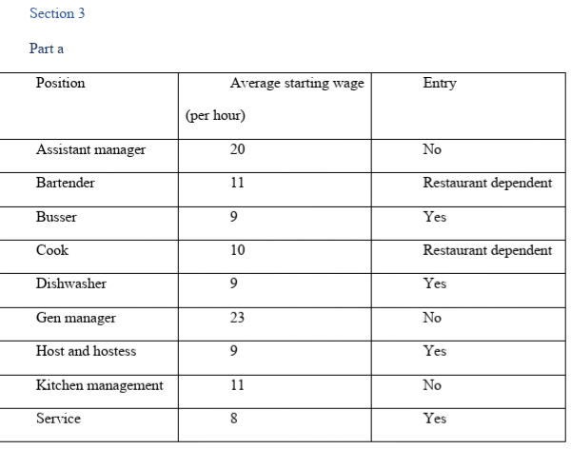

Slide 11
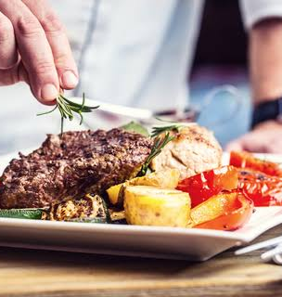
Policies
The food and beverages industry Is a crucial industry hence one should come up with the best safety procedures that should be followed to ensure everything is in check and the rules are followed. Food safety has been considered as one of the most essential tasks given to the cafeteria manager and the staff at large. (Priest et Al 15) The right policies and procedures must be adhered to in order to have a clean environment and avoid any food borne disease that are not allowed to come from the cafeteria

Slide 12
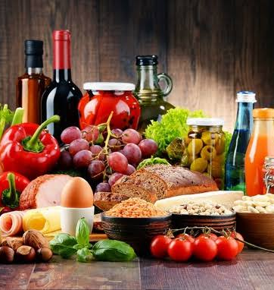
Safety procedures
When it comes to an event or our daily operations in the stadium cafeteria, we need to be well planned and organized to avoid unnecessary confusion due to the high numbers of staff and the clients visiting the stadium. Through this it is then essential to come up with a good staffing guide that plans the cafeteria and shares the responsibilities to each member so that it can have a positive effect to the performance of the company and ensure we have the best service in the region.
Notes:
From every stadium cafeteria preparing programing the tree, people ought to see how their activities influence others so as to help make a culture of solidarity, regard, and appreciation. Remember that new contracts accompany their own encounters and level of information, so make certain to diagram your particular goals and desires and make time to address questions.

Slide 13
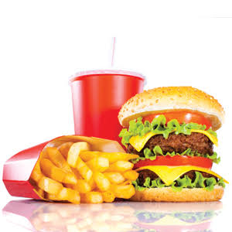
Staffing guide
The Foundation
The organization sets up the establishment of fundamental beliefs, vision, and statements of purpose. These ought to be educated and maintained in all help staff preparing plans. The establishment is pivotal on the off chance that you hold back on the establishment, it's in the long run going to crumple, so ensure you put resources into setting it up before moving onto whatever else.
The Trunk
From establishment we move to the storage compartment of the preparation tree—the data that everybody must know. These things might be about nourishment, computer information, table numbers and area of essential instruments all through the stadium cafeteria.
The Branches
Next we climb to five diverse preparing branches. To begin with, we have the hosts, who must be prepared to be knowledgeable in the stadium cafeteria format, the PC framework, and general tasks.
Notes:
Server programs make up the second and third branches, and projects for barkeeps make up the fourth and fifth branches. These branches start first with work fundamentals, for example, the means of administration servers ought to follow and how barkeeps should tally while pouring. The following level speaks to programs for people who as of now have the essential information, and who may just need to get familiar with the PC framework, menu things, forte beverages, and the design of the stadium cafeteria

Slide 14
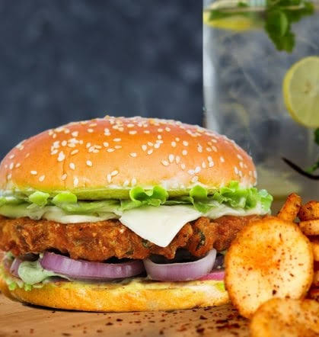
Cleaning and sanitation
Having a proper cleaning and sanitation guide is essential for the stadium cafeteria because having a clean environment for foods means that the customers will have clean food and stay healthy. The government has come up with a sanitation program which was made specifically to oversee all restaurants, hotels, cafeteria and any food joints to ensure they measure up to the health standards given to them by the government. Through this, we have seen set of rules being provided to us to follow and failure to adhere to them will attract huge fines or even get the cafeteria closed. This is why as a company we decided to remain clean and ensure our products are clean. This was helped by having a good sanitation and cleaning guide.
Notes:
Great sanitation begins with having a composed arrangement that is imparted to workers through and through to guarantee purchase in and responsibility. Not exclusively is acceptable sanitation a progression of activities, it is likewise an attitude. Making a decent sanitation convention begins with an intensive examination of an office to distinguish regions and operational practices that could be the underlying driver of a sanitation issue. Within offices, the first-in and first-out stock administration framework is a decent practice to follow. On the off chance that item has been perched on a rack two years past its utilization date, it can ruin and draw in bothers. Make certain to record utilizing a standardized identification framework when item shows up and when the "utilization by" date is drawing closer. Floor channels can be a major issue because of the development of nourishment particles, water, and other natural issue that little flies and cockroaches love. Customary assessment and sanitation medications are an unquestionable requirement. Lounges, cafeterias, storage spaces, and are prime bug problem areas as a result of the plenitude of nourishment and harborage areas. Workers get nourishment and store it (and here and there overlook it) in storage spaces. Nourishment waste may not be appropriately tidied up in lounges and candy machines may have nourishment and fluid spillage. All these are nuisance attractants where standard cleaning and staff instruction are expected to lessen the danger.

Slide 15
Reference
Kanter, Rebecca, et al. "Anticipatory effects of the implementation of the Chilean Law of Food Labeling and Advertising on food and beverage product reformulation." Obesity Reviews 20 (2019): 129-140.
Miles, Gandarvaka, and Anna Maria Siega-Riz. "Trends in food and beverage consumption among infants and toddlers: 2005–2012." Pediatrics 139.6 (2017): e20163290.
Wilson, Amy L., et al. "Nudging healthier food and beverage choices through salience and priming. Evidence from a systematic review." Food Quality and Preference 51 (2016): 47-64.
Sadeghirad, B., et al. "Influence of unhealthy food and beverage marketing on children's dietary intake and preference: a systematic review and meta‐analysis of randomized trials." Obesity Reviews 17.10 (2016): 945-959.
Pries, Alissa M., Suzanne Filteau, and Elaine L. Ferguson. "Snack food and beverage consumption and young child nutrition in low‐and middle‐income countries: A systematic review." Maternal & child nutrition 15 (2019): e12729.
Vlassopoulos, Antonis, et al. "A nutrient profiling system for the (re) formulation of a global food and beverage portfolio." European journal of nutrition 56.3 (2017): 1105-1122.
Yoakim, Alfred, Jean-Paul Denisart, and Antoine Ryser. "Method for preparing a beverage or liquid food and system using brewing centrifugal force." U.S. Patent No. 9,277,837. 8 Mar. 2016.

